Slide 1
DATA ANALYTICS BMI PREDICTION USING LINEAR REGRESSION
ACEEC CSE-C
Presented By:
B. Nagaraju (21AG1A05D8)
B. Sree Kavya Sudha (21AG1A05D9)
D. Sai Kiran (21AG1A05E4)
R. Sahithi (21AG1A05H4)
B. Manipal (21AG1A05D7)
R. Sri Mallika (21AG1A05H6)
R. Meri Prasanna (21AG1A05H5)
D. Sai Varshith (21AG1A05E5)
D. Bhanu Prasad (21AG1A05E3)
R. Archana(22AG5A0517)
Under the guidance of:
Mr. D. Krishna
ASSOCIATE PROFESSOR,CSE

Slide 2
BMI Prediction
The Body Mass Index (BMI) is a statistical measurement that uses your weight and height to estimate your body fat. It is a screening tool, not a diagnostic tool, for identifying potential health risks associated with weight. Traditional BMI calculations might not accurately reflect health risks for individuals across different age groups. This study aimed to develop an BMI prediction model using linear regression in R.
This project utilizes linear regression in R to develop a model predicting Body Mass Index (BMI) based on relevant parameters. Data is collected, preprocessed, and analyzed to determine significant predictors like height, weight, and potentially lifestyle factors. R's lm() function builds the model, which is then evaluated through performance metrics and visualization.

Slide 3
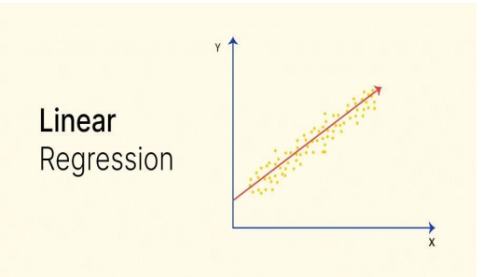
WHAT IS LINEAR REGRESSION?
In statistics, linear regression is a linear approach for modelling the relationship between a scalar response and one or more explanatory variables (also known as dependent and independent variables).
Linear regression analysis is used to predict the value of a variable based on the value of another variable. The variable you want to predict is called the dependent variable. The variable you are using to predict the other variable's value is called the independent variable.

Slide 4
Types of Linear Regression
There are mainly two types in linear regression:
Simple Linear Regression: A linear regression model with one independent and one dependent variable.
Equation :- y = mx + b
Multiple Linear Regression: A linear regression model with more than one independent variable and one dependent variable.
Equation :- y = b + m1x1 + m2x2 + ... + m^nx^n

Slide 5
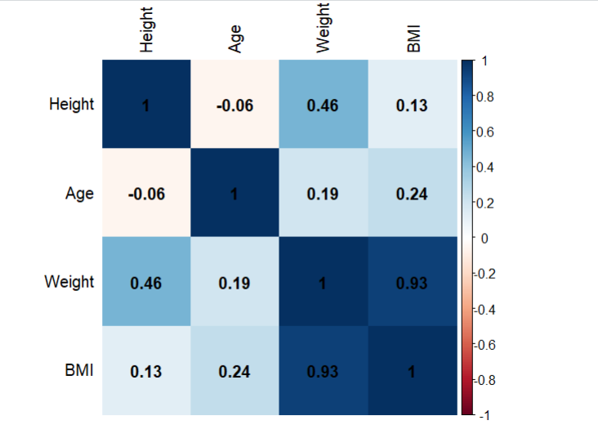
CORRELATION MATRIX
A correlation matrix is simply a table which displays the correlation coefficients for different variables. The matrix depicts the correlation between all the possible pairs of values in a table.
A correlation matrix is a statistical technique used to evaluate the relationship between two variables in a data set. The matrix is a table in which every cell contains a correlation coefficient, where 1 is considered a strong relationship between variables, 0 a neutral relationship and -1 a not strong relationship.

Slide 6
Dataset Description
The objective of the dataset is to predict Body Mass Index (BMI) of the Person.
Target variable or Dependent variable:
BMI: Body mass index (weight in kg/(height in m)^2).
Predictors or Independent variable:
ID: Indicates the id of the Person.
Age: Age of the Person.
Gender: Gender of the Person.
Height: Height of the Person(meters).
Weight: Weight of the Person(kilogram).
Result: Indicates the Obesity Level
This dataset contains 2111 rows and 7 columns.

Slide 7
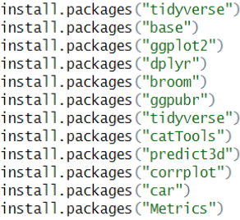
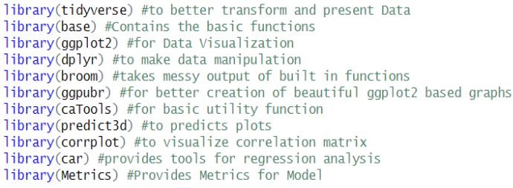
Installing and Loading Required Packages
1. Installing Required Packages into R: 2. Loading packages into R

Slide 8
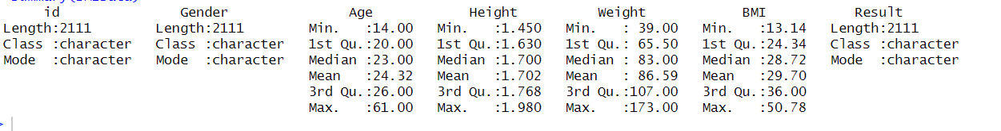
Importing Dataset into R:
Summary of the Dataset: Getting the Complete Summary of the Dataset
Output:

Slide 9
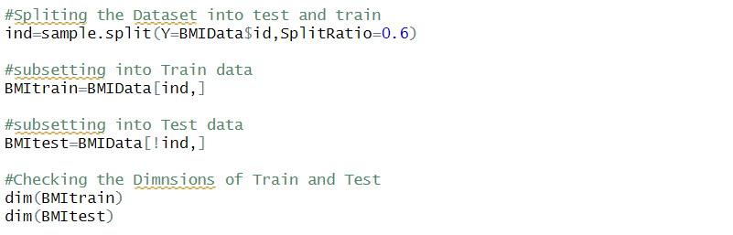
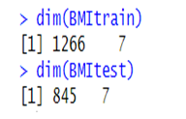
Splitting the Dataset into Test and Train Data : Here we are splitting the Dataset into Test and Train Data. Train Data is used to train the Model and Test Data is used to test the model. We are splitting the Dataset in the ratio of 0.6.
Output:

Slide 10
Checking The Assumptions: We have to make sure that our data meets Assumptions of Linear Regression
We have to make sure that Dependent Variable is normally Distributed. This can be done using hist() function in R.
Then, multicollinearity is another assumption, meaning that the independent variables are not highly correlated with each other. We use cor() function in R to check this.
There must be a linear relationship between the dependent and the independent variables. This can be illustrated by scatterplots showing a linear or curvilinear relationship. By plotting we can verify this.
The homoscedasticity assumes that the variance of the residual errors is similar across the value of each independent variable. One way of checking that is through a plot of the predicted values against the standardized residual values to see if the points are equally distributed across all the values of the independent variables. By Plotting the Model we can verify this.

Slide 11
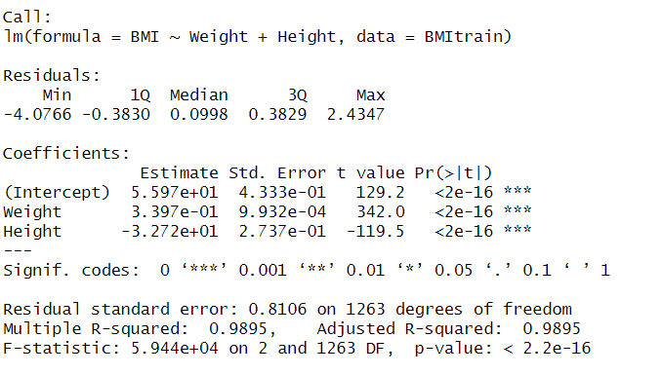
Perform Multiple Linear Regression Analysis On Train Data
CODE :
OUTPUT :

Slide 12
Summary Description
In the above summary, the significant relationships between the Weight and BMI and the Height and BMI were found to be p<0.001.
Multiple R-Squared is 0.989 which means 98% indicates the strength of the Linear Relationship.
Residual Standard Error Calculates the average distance that the observed values fall from the Regression Line.
Finally we conclude from Summary, The BMI value is increased by 0.33 for every increase in one kilogram of weight. The BMI values is decreased by .32 for every increase in 1 centimeter of Height.

Slide 13
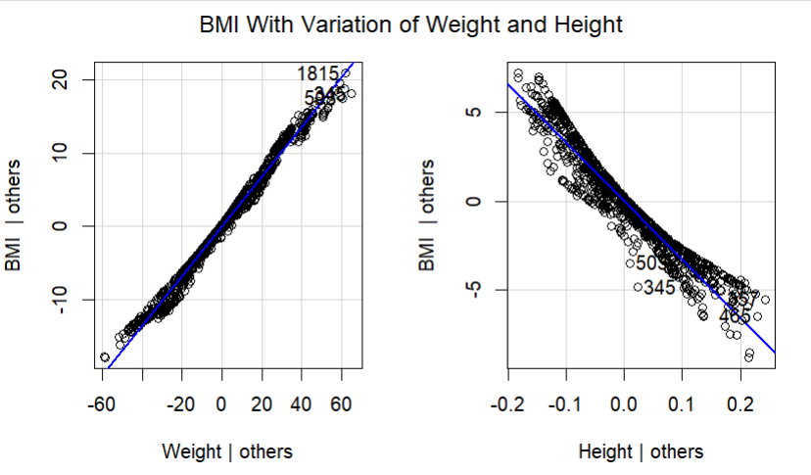
Added Variable Plots For the Regression Model:-AV plots are used in Multiple Linear Regression. It is used to plot the Dependent Variable with Independent Variable Separately.
CODE :
OUTPUT :

Slide 14
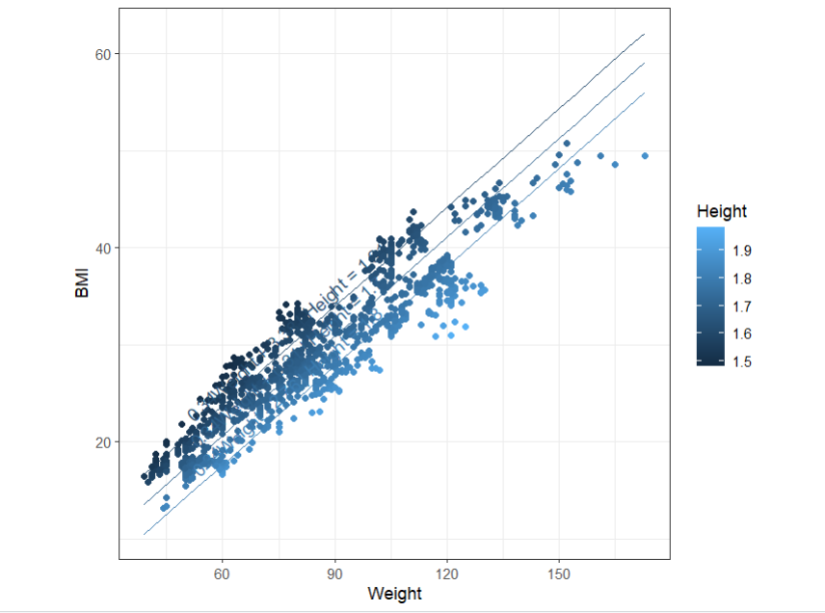
Plotting the Regression Model:-In this plotting the Regression Model using the ggPredict(), which is used only for multiple linear regression Model. Which plots the Dependent Variable as a function of independent variables.
CODE :
OUTPUT :
Changes in BMI As a Function of Weight and Height

Slide 15
Predicting Model:-Now we have to Test the Regression Model on Test Dataset. And Plotting the Predicted Values and Actual Values.
Code:- To Predict the BMI values on Test Dataset
Code:- Rounding the values of Height up to 1 decimals so that we can group according to Height
Code:- Changing the Height Variable into Factor

Slide 16
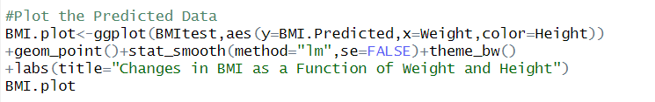
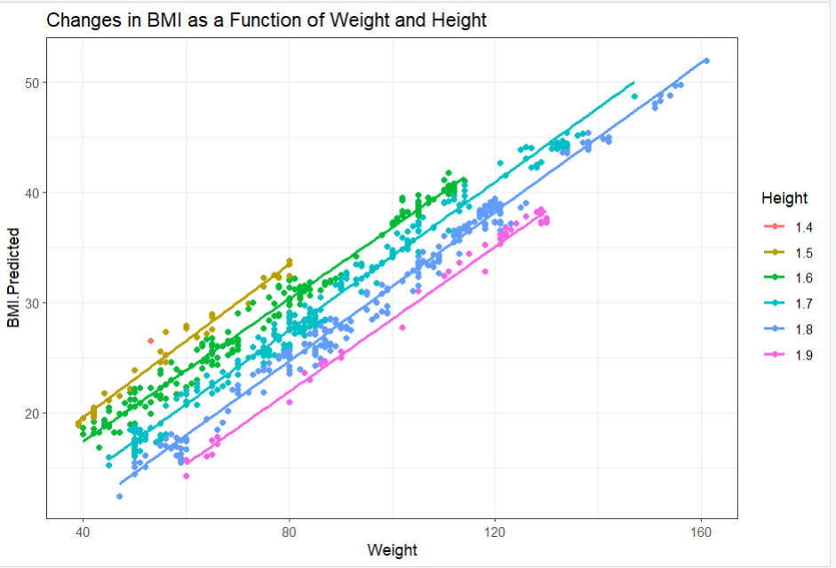
Plotting the Predicted Data using ggplot()
CODE :
OUTPUT :

Slide 17
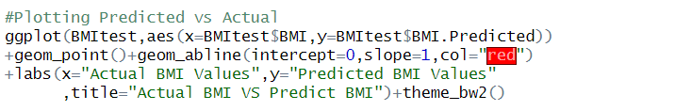
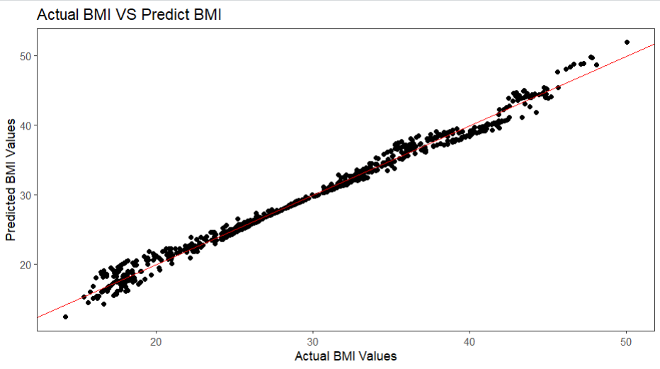
Plotting Predicted vs Actual On Test Data:- Now we are plotting the Actual and Predicted BMI values on Test Dataset so that we can visualize the model accuracy. Plotting the graph by taking Predicted BMI on Y axis and Actual BMI on X-axis
CODE :
OUTPUT :

Slide 18
CONCLUSION
The multiple linear regression model developed in this project significantly improved BMI prediction compared to simpler models. Using Independent variables i.e Using Weight and Height, the model explained 98.9% of the variance in BMI with an adjusted R-squared of 0.989.
Weight showed the strongest positive association with BMI, suggesting that 0.33.Conversely, Height had a negative association, indicating 0.32. These findings highlight the complex interplay of factors influencing BMI and provide valuable insights for healthcare and fitness.

Slide 19
BIBILOGRAPHY
Dataset Link:-https://www.kaggle.com/datasets/mandysia/obesity-datasetcleaned-and-data-sinthetic
YouTube Reference Video:- https://youtu.be/UomnHPBfvBc?si=P0TJk0GDP80xSqlU
Regression Analysis using R:-
https://www.scribbr.com/statistics/linear-regression-in-r/

Slide 20
THANK YOU….
Any Doubts…..!?

